Slide 1
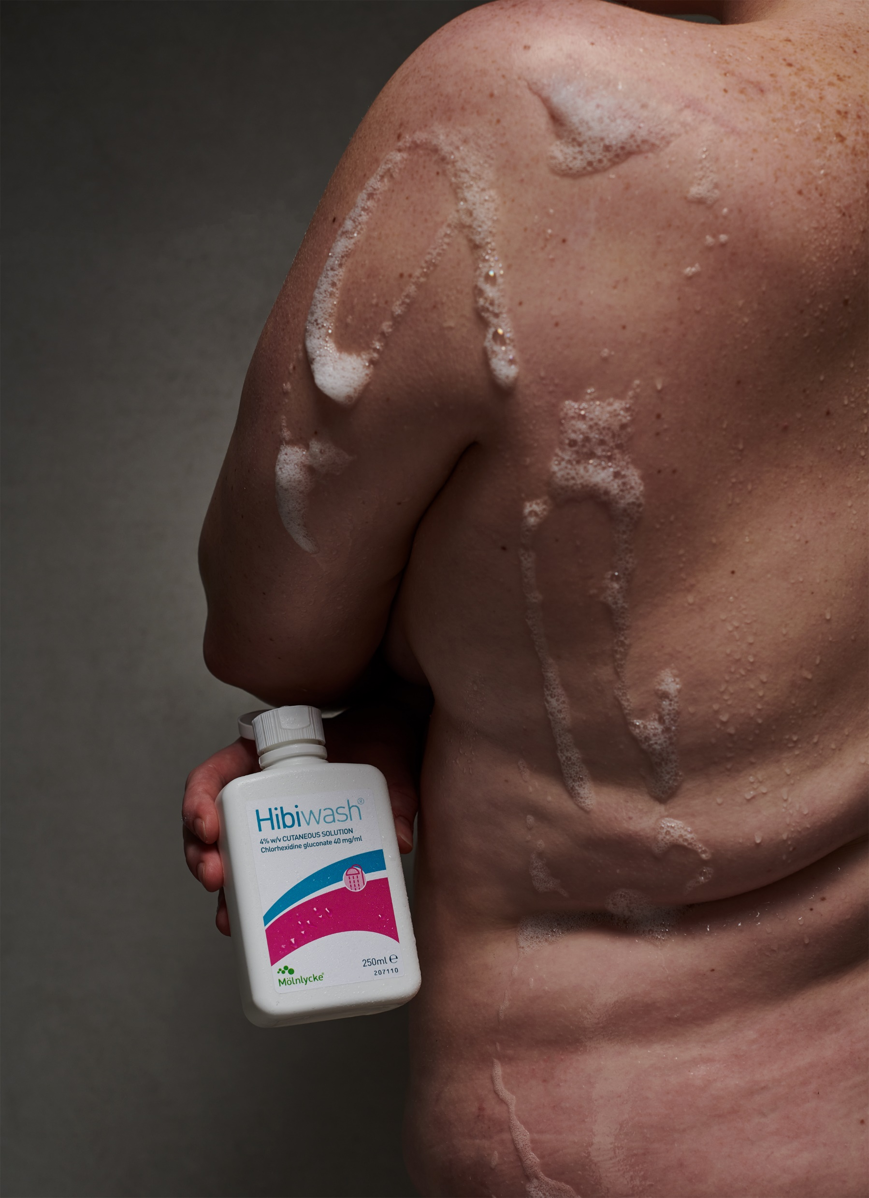
Molnlycke & Antiseptics UK
Hibiwash® HiBi® Liquid Hand Rub+

Slide 2
Agenda
Aim of the training and objectives
About Molnlycke
Introduction to Antiseptics
The importance of skincare
Pathogens and MDROs
Surgical site infections
Our product range & Chlorhexidine Gluconate
Whole body washing
Q&A

Slide 3
Aim of the training and objectives
This programme comprises of:
  Introduction to Molnlycke Health Care
  The products and solution that support healthcare providers and patients fighting infections
  The basics on the microorganisms and MDROs
  The risk of SSIs and the importance of the Surgical hand wash and the Whole body wash
  The importance of skincare as part of optimal hand and skin antisepsis against infections
On completion of this programme you should be able to:
  Understand the importance of surgical hand washing and whole body washing in preventing the spread of infections
  Know the different types of microorganisms and how and why they spread
  Identify Skincare as an important part of fighting infections
  How Molnlycke is your partner in reducing infection and creating a safer Healthcare environment for the patients and healthcare providers

Slide 4
About Molnlycke

Slide 5


A world-leading medical solutions company
Our purpose is to revolutionise care for people and planet
To advance performance
in healthcare across the world
To aspire and to equip everybody in healthcare with solutions to achieve the best outcomes

Slide 6



Our values

Slide 7


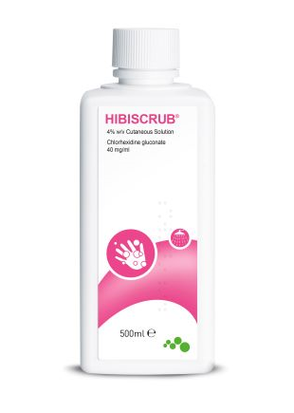


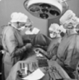
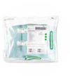

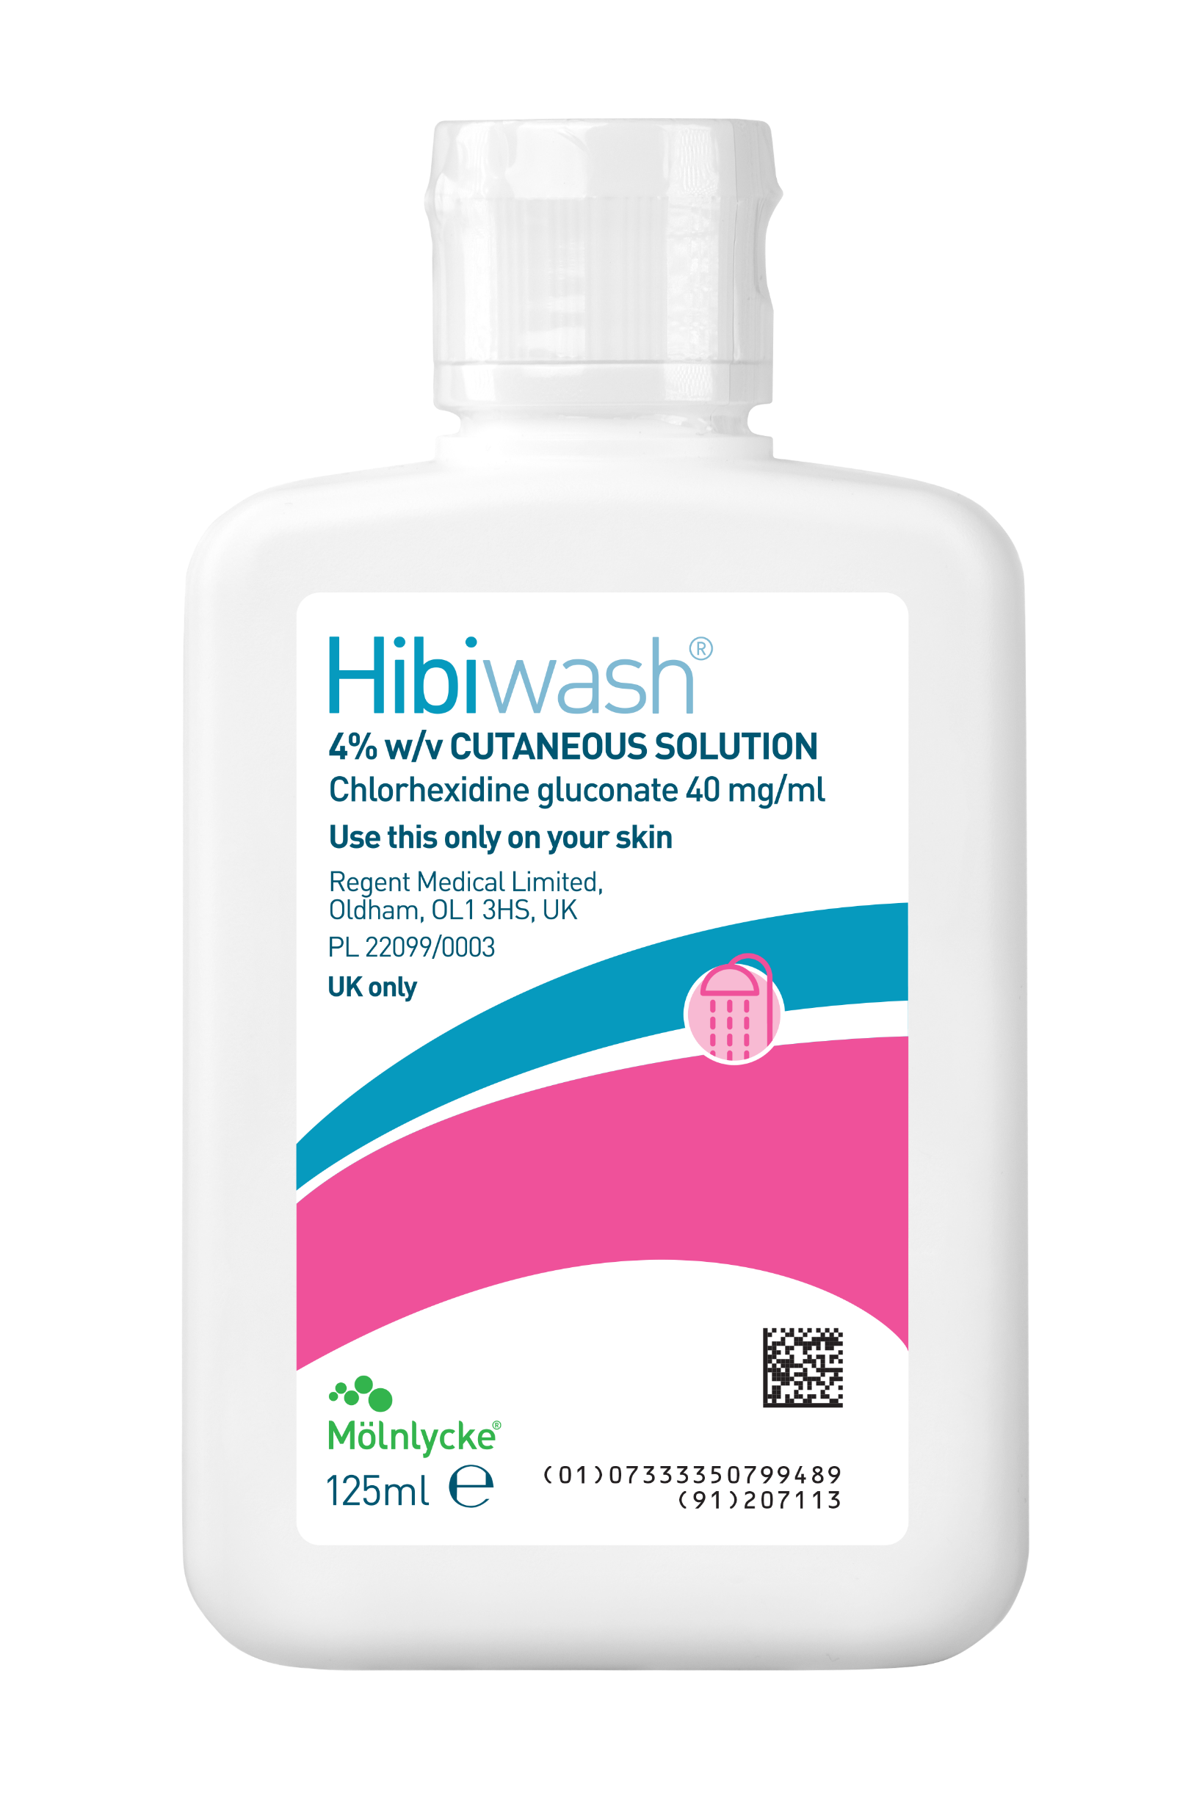
We’ve come a long way since we started
1849
Mölnlycke AB is founded
1950s
Industrial manufacturing of swabs
and wound dressings pioneered
1980s
Safetac® technology and
Mepitel® wound contact layer
2000s
2004 Molnlycke Healthcare sold to APEX, the Regent company created & the well known Hibiscrub
2020s
Mepilex® Border Flex and
Granulox® oxygen therapy
1920s
Industrially produced
gauze is used to make
swabs and dressings
1960s
New materials and techniques
are introduced to reduce
bacteria spreading
1990s
Mepitel®, Mepiform®, Mepilex®
and Mölnlycke customised
procedure trays
2010s
Pressure ulcer prevention
2020s
New Antimicrobial Full Body
Wash - Hibiwash®
Notes:
We’ve seen a lot of change in 170 years,
but then again we’ve been looking for it
1849 Mölnlycke AB is founded as a textile business. By the early 1900s the company becomes one of the main suppliers of gauze to Swedish hospitals.
1920s Swabs and dressings are prepared by nurses and patients, using industrially produced gauze. Dirty gauze is often laundered and re-used.
1950s Mölnlycke pioneers the industrial manufacturing of swabs and wound dressings in Sweden, gradually replacing hospital manual work with pre-packed products.
1960s Mölnlycke introduces a range of new materials and techniques designed to reduce bacteria spreading. The company focuses on promoting the change from multi-use textiles to ready-packed, single-use dressings, drapes and surgical gowns.
1980s Tomas Fabo invents the revolutionary Safetac® technology, which reduces pain and tissue damage in wound management. In 1989 Mölnlycke launches Mepitel® wound contact layer – the first product using Safetac.
1990s Thanks to continued strong growth, Surgical and Wound Care are divided into two full-fledged business areas. Flagship wound-care products include Mepitel®, Mepiform® and Mepilex®. ProcedurePak® trays are introduced in 1999.
2000s Success continues with the introduction of Barrier®-branded gowns and drapes. Mepilex® Border is launched in 2001 to treat chronic wounds. In 2004
Nordic Capital sold Mölnlycke Health Care to APEX, which had a number of small
surgical companies in its corporate profile. These were then integrated into Mölnlycke. This
expanded the range with products such as disinfectants and surgical gloves. The company was called Regent, and the disinfectant in question is the well known Hibiscrub® In 2005
Mölnlycke Health Care is acquired by APAX and merged with Regent Medical and Medlock
Medical. The Regent factories in Malaysia specialise in surgical gloves and are at the forefront
in terms of product design, processes and quality control.
The Medlock factory in England manufactures a special range of wound care products.
The range also includes disinfection solutions.
2010s Mepilex® Border Heel and Sacrum are created to help treat and prevent pressure ulcers. Mölnlycke creates its third business area, Prevention.
2020s We continue to advance healthcare with flexible Mepilex® Border Flex dressings and Granulox® oxygen therapy and the new antimicrobial full body wash Hibiwash®in 2024
Acquisitions
1975 Acquired by SCA
2005 Merged with Regent Medical and Medlock Medical
2007 Acquired by Investor AB
2008 Acquired Pharmaset
2009 Acquired JKT
2010 Acquired Rynel
2016 Acquired Sundance

Slide 8


Making a difference all around the world
39
Countries with sales
and marketing
offices
Notes:
Our story started in Sweden, but today we’re a truly global healthcare company. We pay close attention to every step in the supply chain: training our staff to be the best and aspiring to the most precise manufacturing standards. We take great care in everything we do and are proud to be trusted partners to hospitals and healthcare professionals around the world.

Slide 9


We value our people and we’re proud of the experts within our business
8,775
Employees
globally

Slide 10



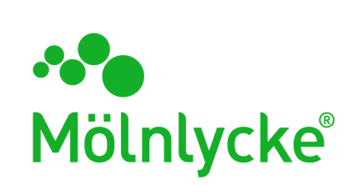
Restoring smiles around the world
USD 5m
made up of employees fundraising and in-kind donations
Since 2004, we've been proud to support Operation Smile, a charity that provides safe, free cleft lip and cleft palate repair surgery for children with facial deformities.

Slide 11






We are committed to becoming a more sustainable business

Slide 12
Antiseptics
Notes:
In our session, we will do a brief introduction on our skin and microorganisms, focus on the importance of WBW (with HiBi of course), how to safely use our product and a brief overview of the national guidance focusing on this matter. Finally, we’ll open the floor to some questions from you and a bit of a discussion

Slide 13

Antiseptics- Who are we?
A recognised global leader in Infection Prevention, providing unique solutions that:
prevent and eliminate infection
protect patients and healthcare providers
provide a safer environment where it matters

Slide 14
Why skincare is important

Slide 15
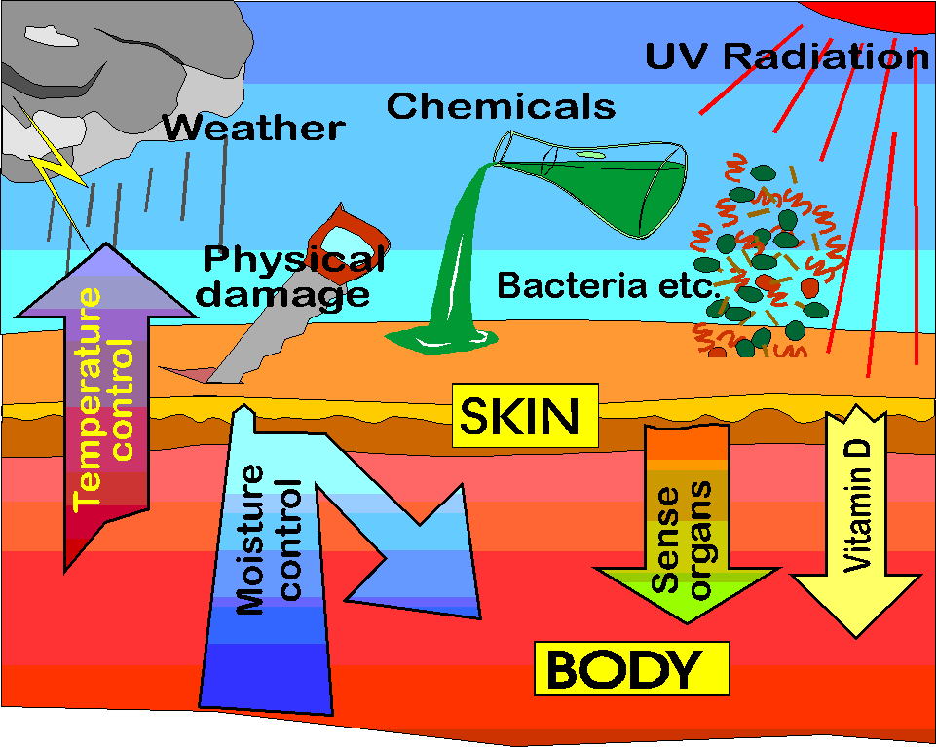
The Structure and Function of the skin
We know that our skin can be damaged by strong sunlight, smoking, diet and stress. However, hand and body antisepsis, also takes its toll, due to the repetitive nature of skin cleansing required when working in healthcare or before your surgery.
The best way to look after our skin is to take a preventative approach to promote healthy skin.
Our skin is simply our protective covering, to keep healthy the skin must remain intact and its barrier function must not be compromised ¹
IMAGE FOR INTERNAL USE ONLY
1. Article on Nursing Times magazine 25 November 2019.

Slide 16
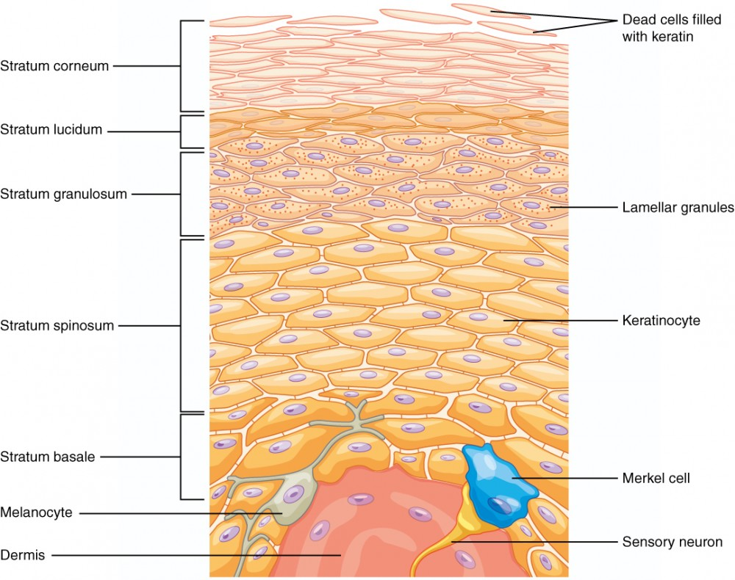
Skin’s structure
IMAGE FOR INTERNAL USE ONLY
1. Teach me anatomy website
Notes:
The Epidermis
Our skin consists of two main layers: the epidermis or outer layer, and the dermis which lies beneath the epidermis. The skin also contains a number of accessory organs which assist in its protective role.
The prime function of the epidermis is to act as a physical and biological skin barrier to the external environment, preventing penetration by irritants and allergens.
The epidermis is the outermost layer of the skin and is composed of 5 layers:
Stratum Corneum (or horny layer) – our skin barrier
Stratum Lucidum - only found on the hands, fingertips and soles of feet
Stratum Granulosum - where part of keratin production occurs
Stratum Spinosum - gives the skin strength and flexibility
Stratum Basale – where keratinocytes are produced
The Stratum Corneum
Our skin barrier, the stratum corneum, is sometimes described as a brick wall, our skin cells are the brick and our natural oils as the mortar (cement).
The bricks are the corneocytes (dried out skin cells that are ready to shed). The mortar is the intercellular matrix, which is composed of lipids. This brick wall structure makes the skin impermeable to foreign invaders, such as irritants, allergens, and microorganisms.
This brick wall also prevents water loss (called transepidermal water loss). The lipids (in the mortar) are responsible for maintaining the skin’s hydration, firmness, and smoothness.
If the skin on our hands gets dry, flaky, or sensitive this is usually due to a damaged skin barrier function.

Slide 17
Pathogens & MDROs

Slide 18
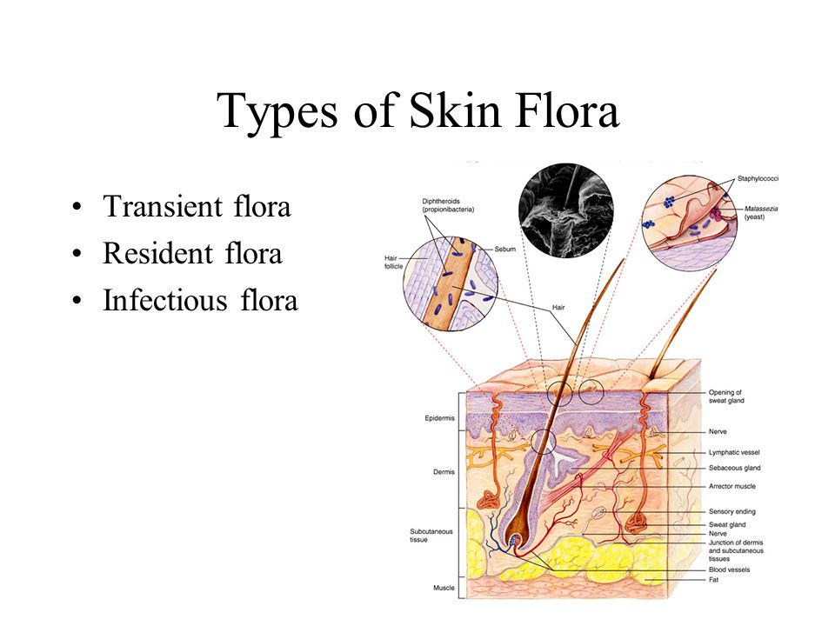
Resident and Transient organisms
Exposure of patients to pathogenic microorganism transferred by hands, surfaces and aerosols can lead to Hospital Acquired Infections (HAIs)
Our products aim to reduce the levels of pathogens associated with SSIs
IMAGE FOR INTERNAL USE ONLY
Notes:
Resident
Deeper skin layers (under stratum corneum)
Can re-grow if disturbed (thrive)
Not removed by routine washing
Not usually associated with infection transmission
Protective organisms
e.g. – Staphylococcus epidermidis
Transient
Top skin layer (in stratum corneum)
Do not re-grow if disturbed (survive)
Removed by effective washing
One of the root cause of infection transmission
Pathogenic organisms
e.g.- Staphylococcus aureus

Slide 19
Pathogens
Can live on the environment for days, weeks or months^{8,9,10,11}
IMAGE FOR INTERNAL USE ONLY
8 “Contamination, disinfection, and cross-colonization: are hospital surfaces reservoirs for nosocomial infection?”, Hota B et Al., Clin Infect Dis. 2004 Oct 15;39(8):1182-9. Epub 2004 Sep 27.
9 “How long do nosocomial pathogens persist on inanimate surfaces? A systematic review”, Kramer A, BMC Infect Dis. 2006; 6: 130.
10“Do infection control measures work for methicillin-resistant Staphylococcus aureus?”, HAvill NL et al., Infect Control Hosp Epidemiol. 2004 May;25(5):395-401
11 “Understanding and Preventing Transmission of Healthcare-Associated Pathogens Due to the Contaminated Hospital Environment”, Weber DJ et Al., Vol. 34, No. 5, Special Topic Issue: The Role of the Environment in Infection Prevention (May 2013), pp. 449-452
Notes:
In this slide we can see how long microorganisms can survive in the environment. This information is particularly important when considering the transmission/contamination potential when touching surfaces, objects and so forth. Washing your skin with an antimicrobial soap is known to be a fundamental way to prevent spread of infection not only in the healthcare environment but also in the community.

Slide 20
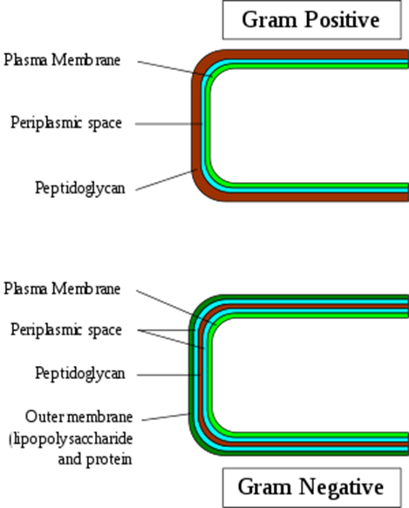
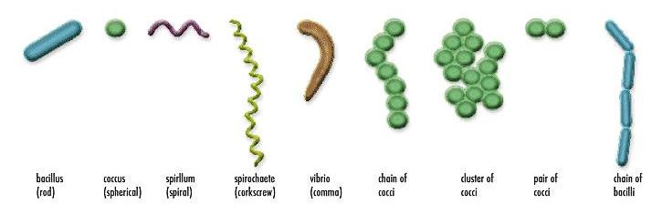
Bacteria
Unicellular microorganisms
Found everywhere in nature
Passed through touch, air, ingestion
Most commonly related to SSIs
IMAGES FOR INTERNAL USE ONLY
Notes:
Gram positive bacteria possess a thick (20–80 nm) cell wall as outer shell of the cell. In contrast Gram negative bacteria have a relatively thin (<10 nm) layer of cell wall, but harbour an additional outer membrane with several pores and appendices. Gram-positive bacteria cause tremendous problems and are the focus of many eradication efforts, but meanwhile, Gram-negative bacteria have been developing dangerous resistance and are therefore classified by the CDC as a more serious threat.

Slide 21
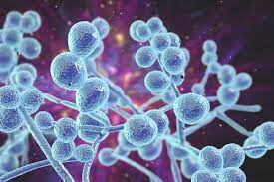
Fungi and Yeast
Fungal and yeast spores are found in the air and soil which can then be inhaled or transferred through touch. Infections mainly start in the lungs or on the skin
Treated using antifungals however these are not always successful due to the nature of fungi/yeasts
IMAGE FOR INTERNAL USE ONLY

Slide 22
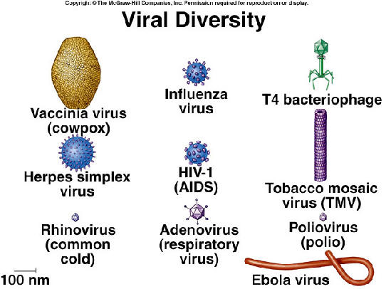
Viruses
Viruses of concern include the influenza and chicken pox can be transferred through aerosols, contact with contaminated fluids
Viruses infect target cells which can then live harmlessly within the body in a dormant state until the activated by external factors or cause chronic, lifelong infections
Some viruses can be treated with antivirals to but most infections can only really involve treating the symptoms and reduce transmission from the reservoirs
IMAGE FOR INTERNAL USE ONLY
Notes:
Harmless = Herpes simplex (external factors mainly reduced immune system due to stress/other illness causes it flare up ie-cold sores)
Chronic = Hepatitis
Coronavirus = enveloped (some evidence for HLHR+ and potentially with CHG as an active)

Slide 23

MDROs ( multidrug resistant microorganisms) risks
What is a multi-drug resistant organism?
Examples of bacteria that can become multidrug-resistant?
Colonisation and infection – What’s the difference?
Why should I be concerned about antibiotic resistance?
IMAGE FOR INTERNAL USE ONLY
Notes:
What is a multi-drug resistant organism?
It is a bacterium that is resistant to several antibiotics, capable of causing infection and often adapted to spread easily. These bacteria are sometimes also called ‘superbugs’.
Examples of bacteria that can become multidrug-resistant?
Gram-negative organisms (for example E.coli, Klebsiella or Pseudomonas).
Gram-positive organisms (for example Vancomycin-resistant Enterococcus (VRE)).
Colonisation and infection
A person can be either ‘colonised’ or ‘infected’ with a MDRO.
‘Colonised’ means that a person has the bacteria present on the skin, in body openings or in the gut, but has no signs of infection.
'Infected’ means that a person has signs of an infection, such as fever or pus from a wound.
Why should I be concerned about antibiotic resistance?
Almost every type of bacteria has become less responsive to antibiotic treatment and this means infection can become difficult or impossible to treat. Someone who is colonised or infected with a MDRO can pass this on to another person and difficult to treat infections can spread

Slide 24
Surgical Site Infections ( SSIs)

Slide 25
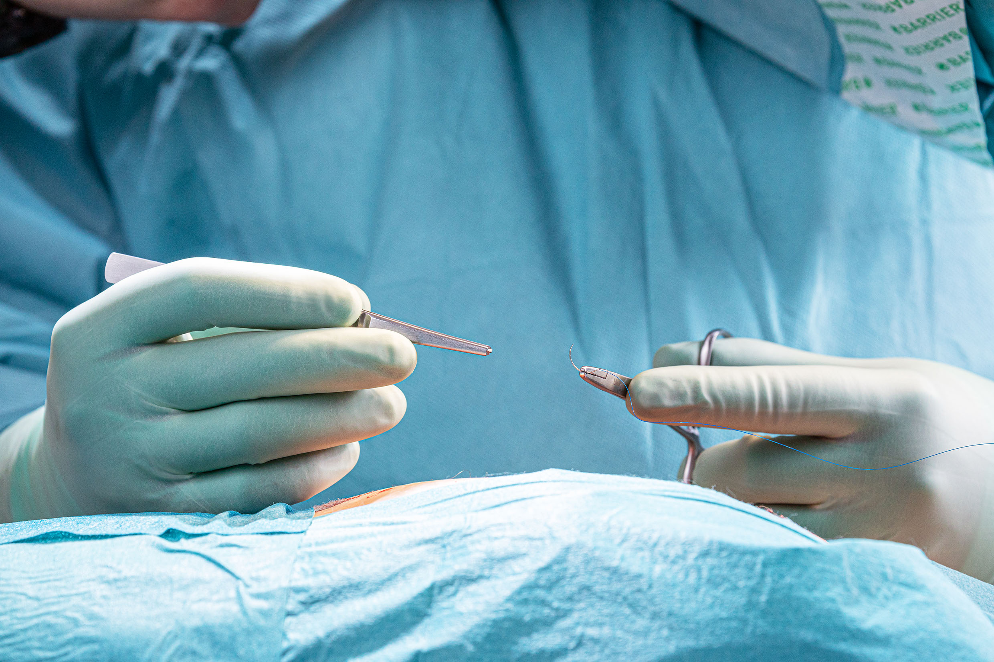
Surgical Site Infections – A risk to eliminate
Major implications on patients lives and on the healthcare systems
Increased use of antibiotics and the potential increase of antimicrobial resistance
Infection prevention has a vital role to play in eliminating the risks introducing the right interventions & act proactively
Notes:
The vital role of infection prevention has never been higher in both the public consciousness – or on the agenda of healthcare professionals.
As elective care begins to resume across the country, now is more important than ever to minimise the risks of healthcare associated infections, such as surgical site infections (SSIs).
SSI’s are a problem of increasing concern with major implications for both patients and the NHS
In addition to the impact on patients lives SSIs have wider implications but also health outcomes, such as the use of antibiotics for treatment and the risk of antimicrobial resistance

Slide 26
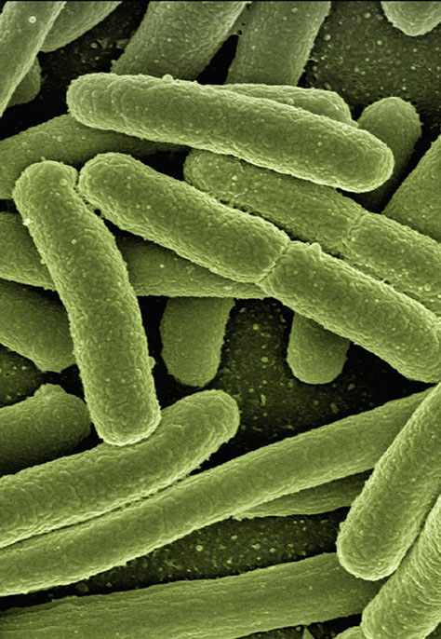
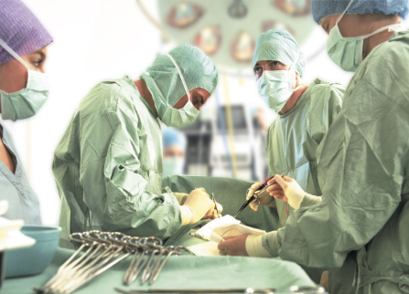
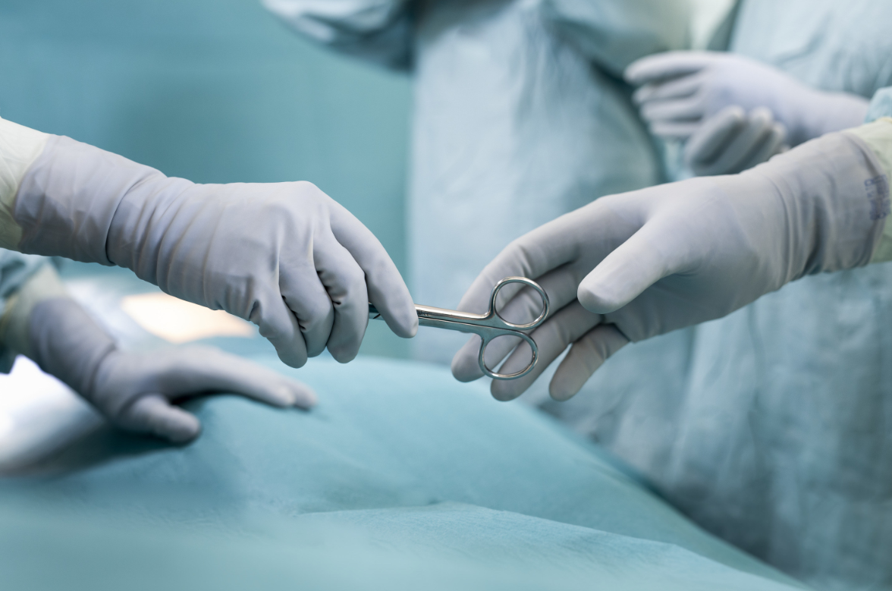
The problem: Surgical Site Infections (SSIs)
An infection that occurs after invasive surgery in the location where the surgery took place and the second most frequent type of HAI in EU¹
10% in lower income countries will have a HAI²
Facing…
The estimate cost of SSIs in EU is between €1.47 and €19.1 billion¹
Delays in discharge with an average
hospital stay of 6.5 days in EU and 9.7 days in US¹
  A negative impact on patient’s quality of life
  To name just a few of the life-changing side effects
7% patients in high income countries will have a HAI²
11.8% avg. of surgeries will result in a SSI²
  https://www.ncbi.nlm.nih.gov/books/NBK536426/
  https://www.who.int/gpsc/country_work/gpsc_ccisc_fact_sheet_en.pdf

Slide 27
Hibiwash®
& Chlorhexidine Gluconate

Slide 28
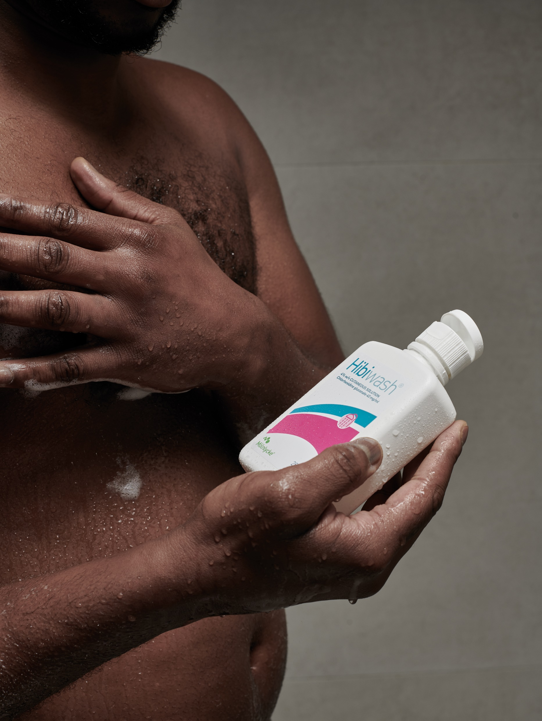
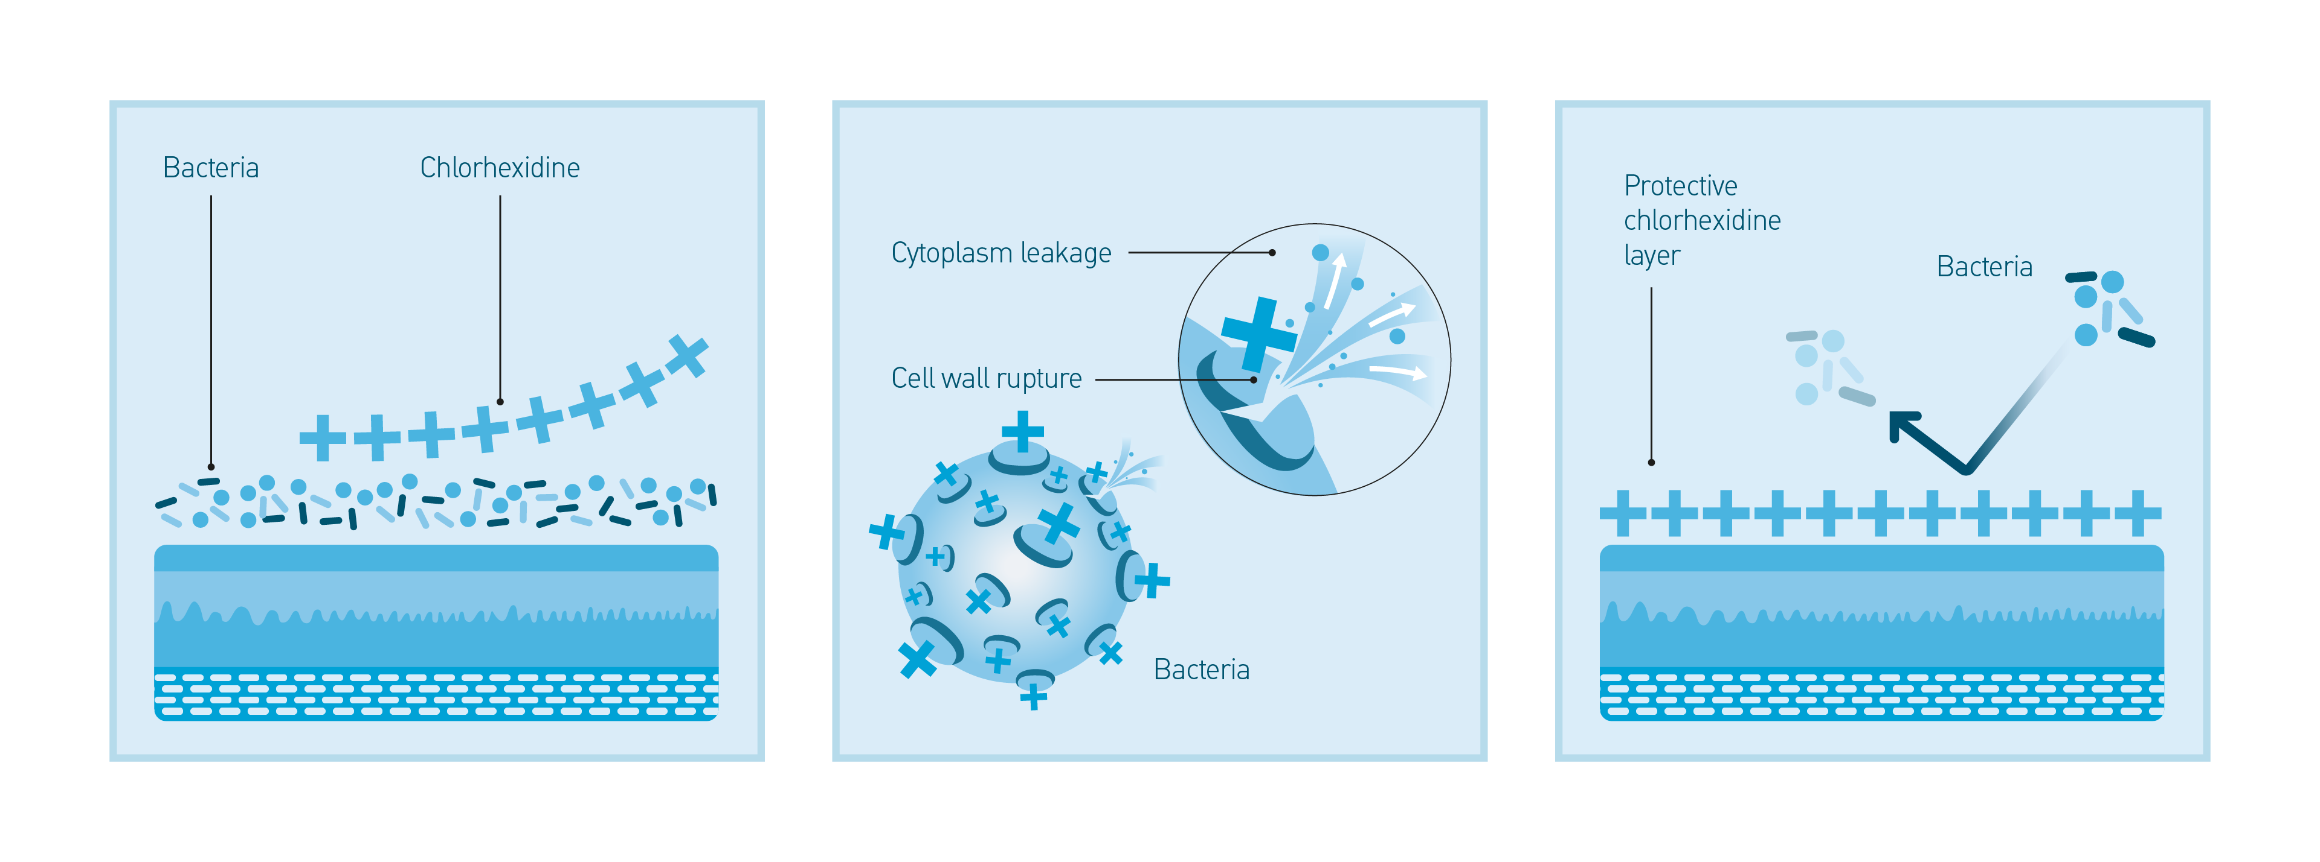
Chlorhexidine gluconate – how does it work?

Slide 29

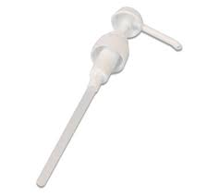
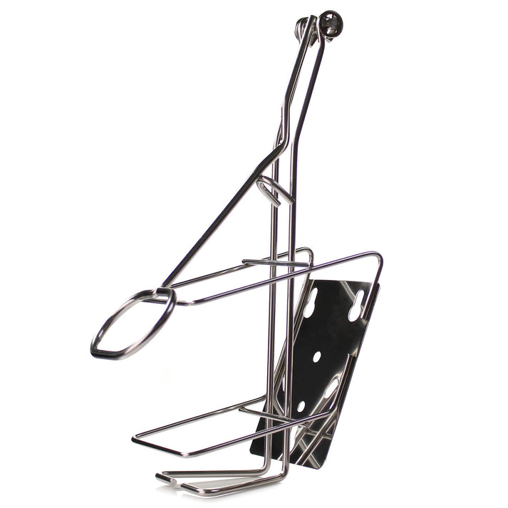
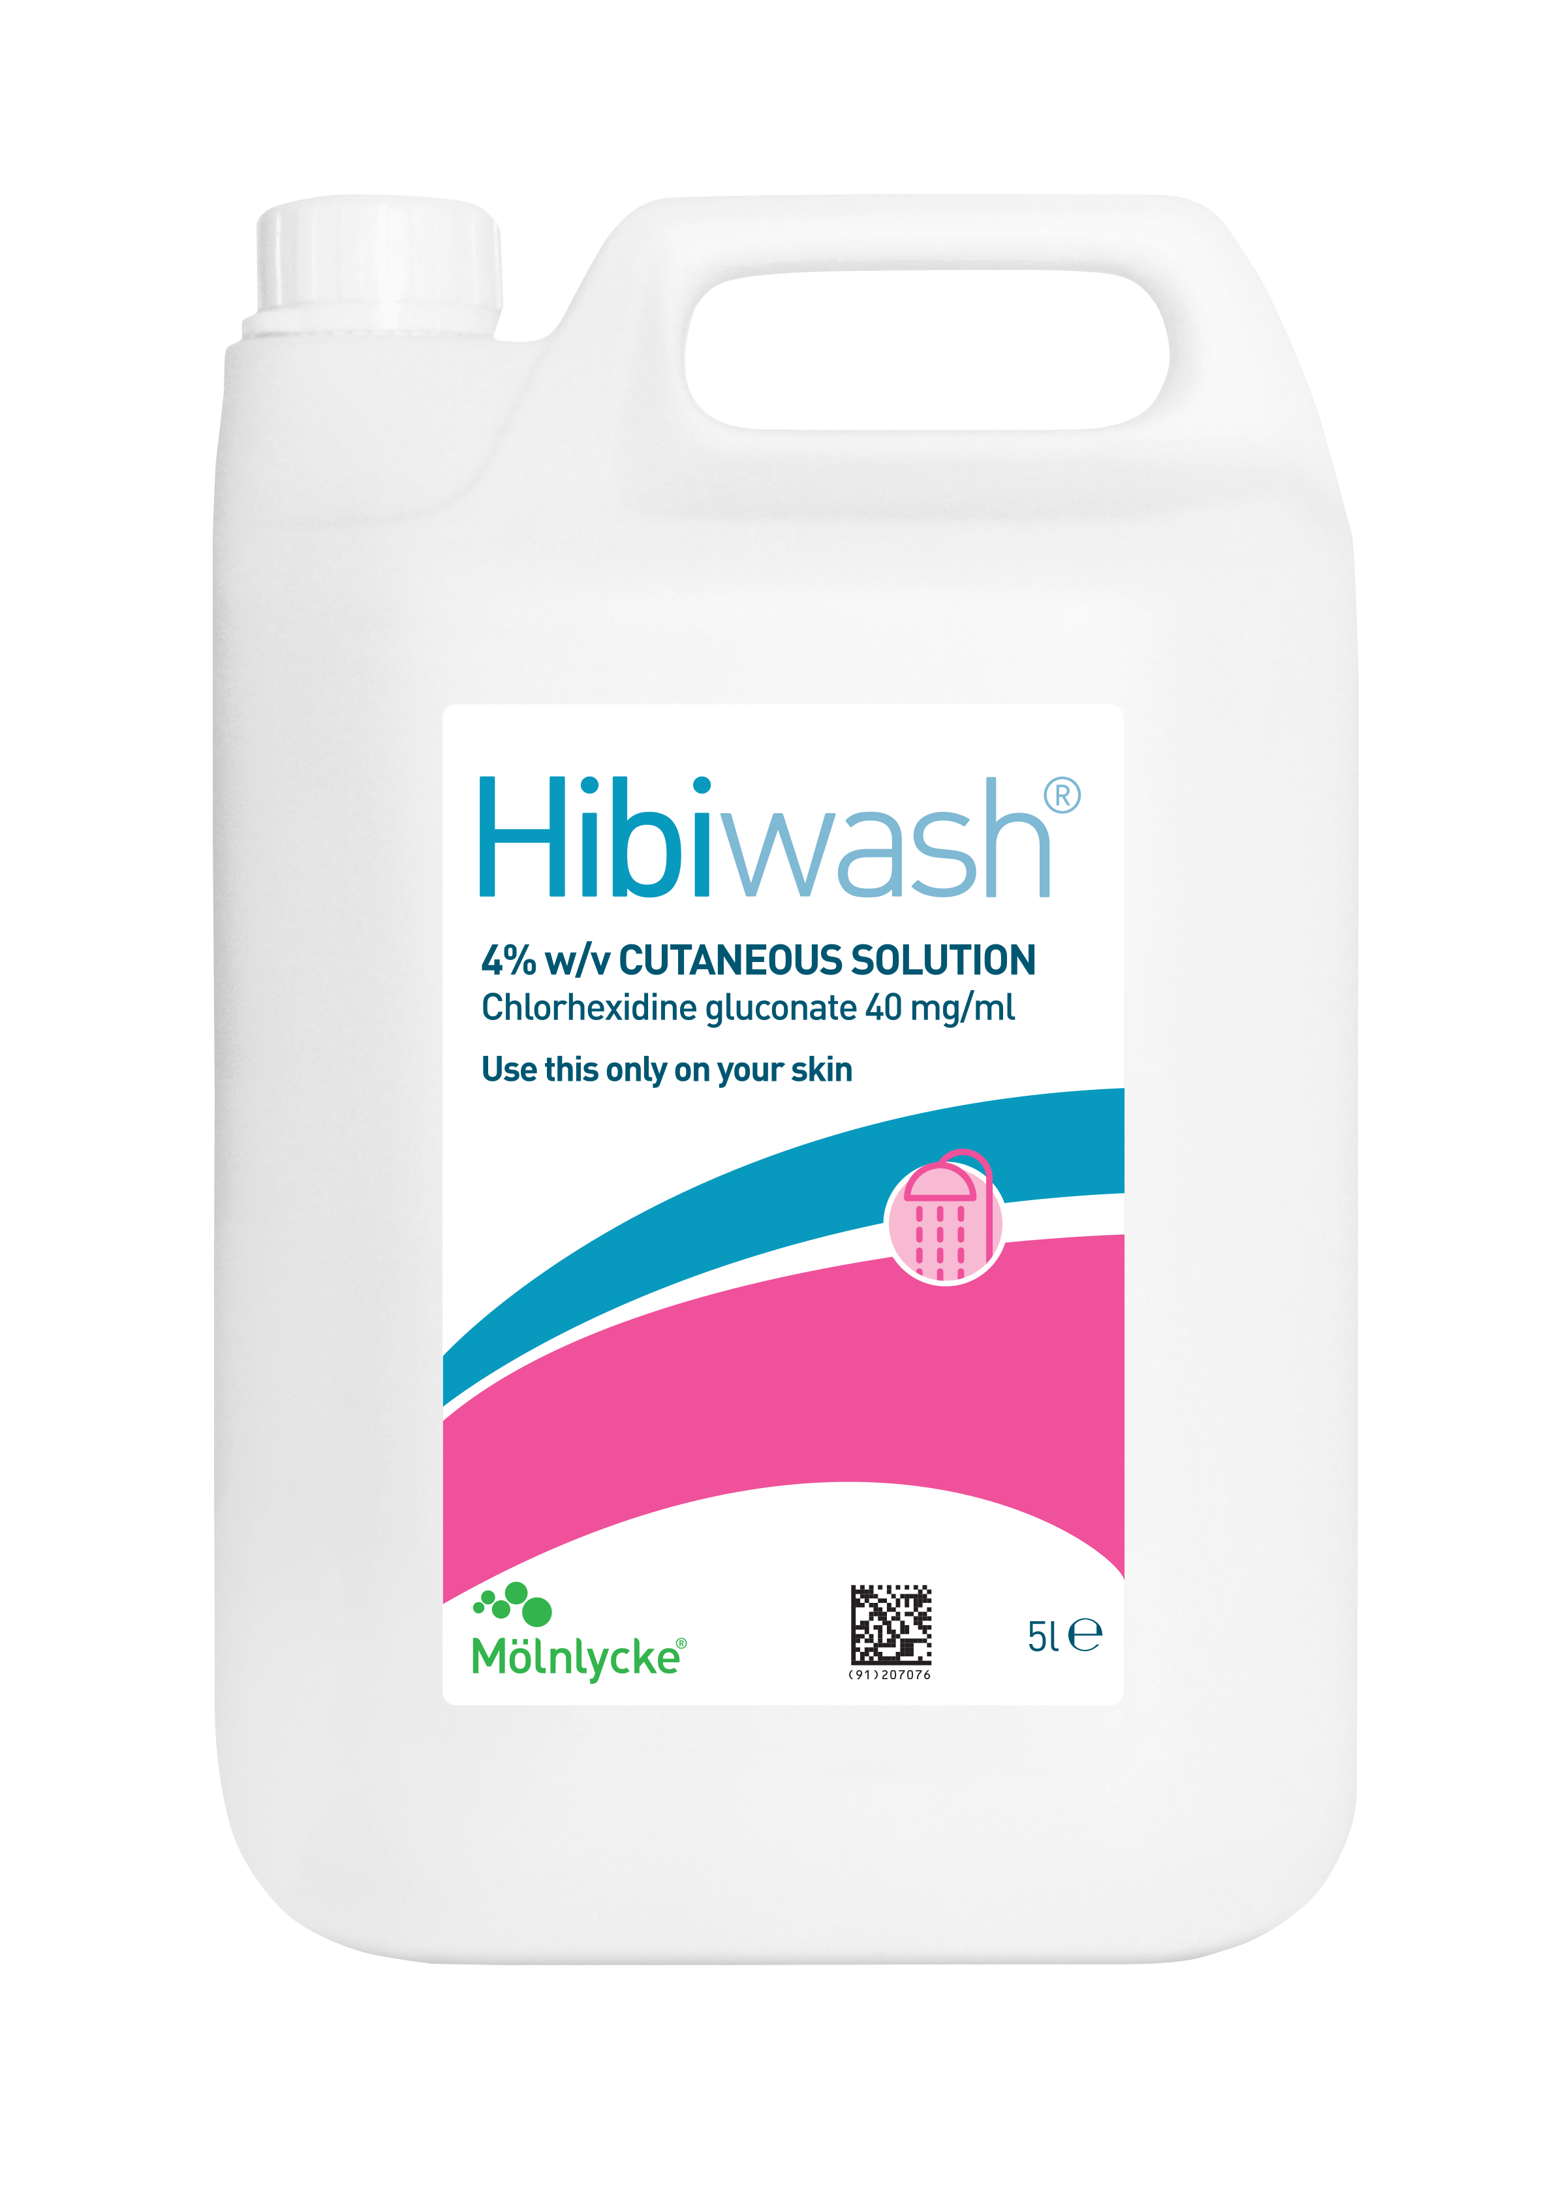
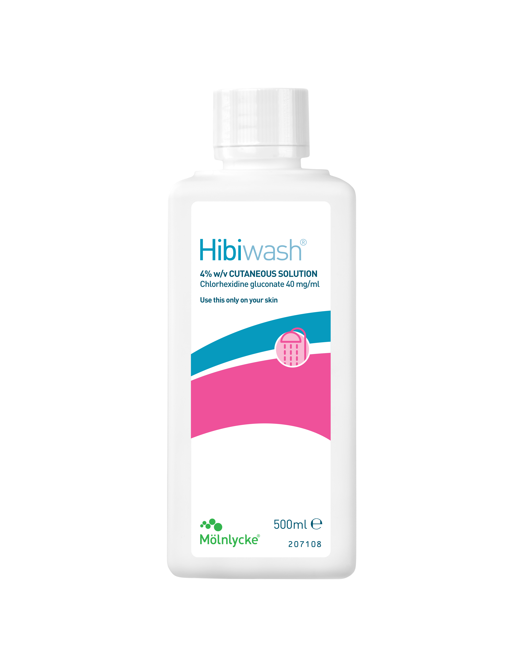
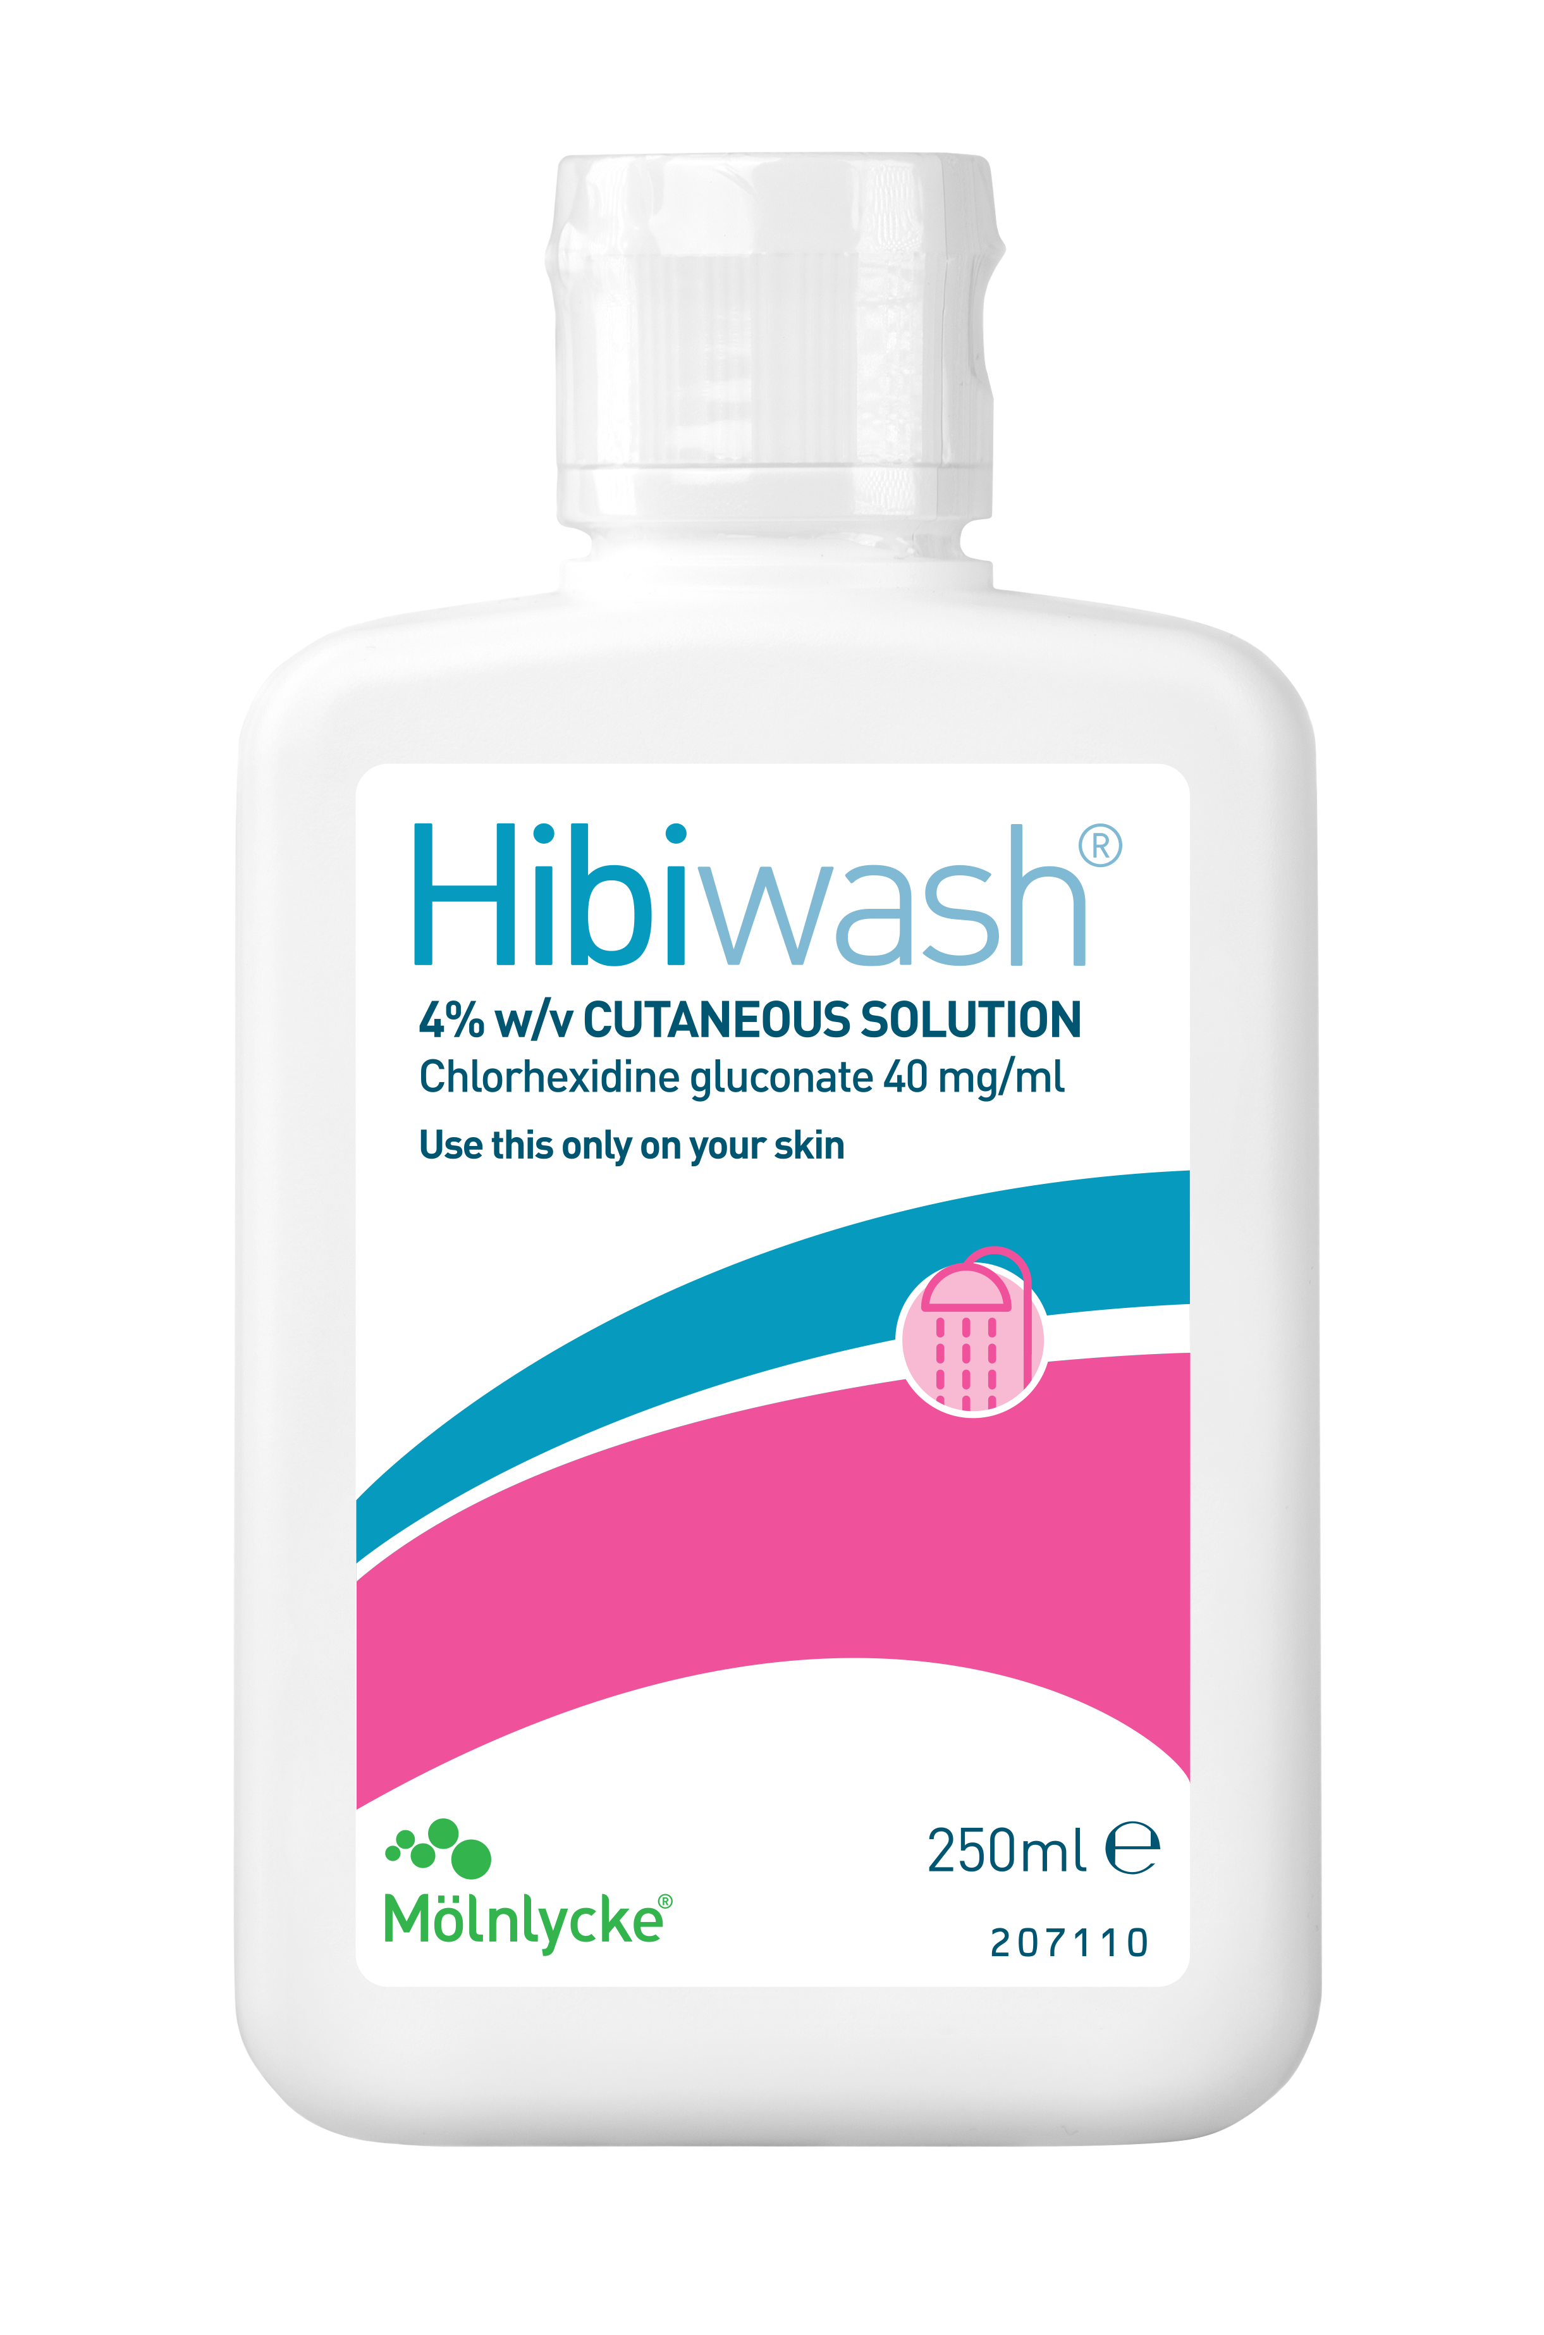
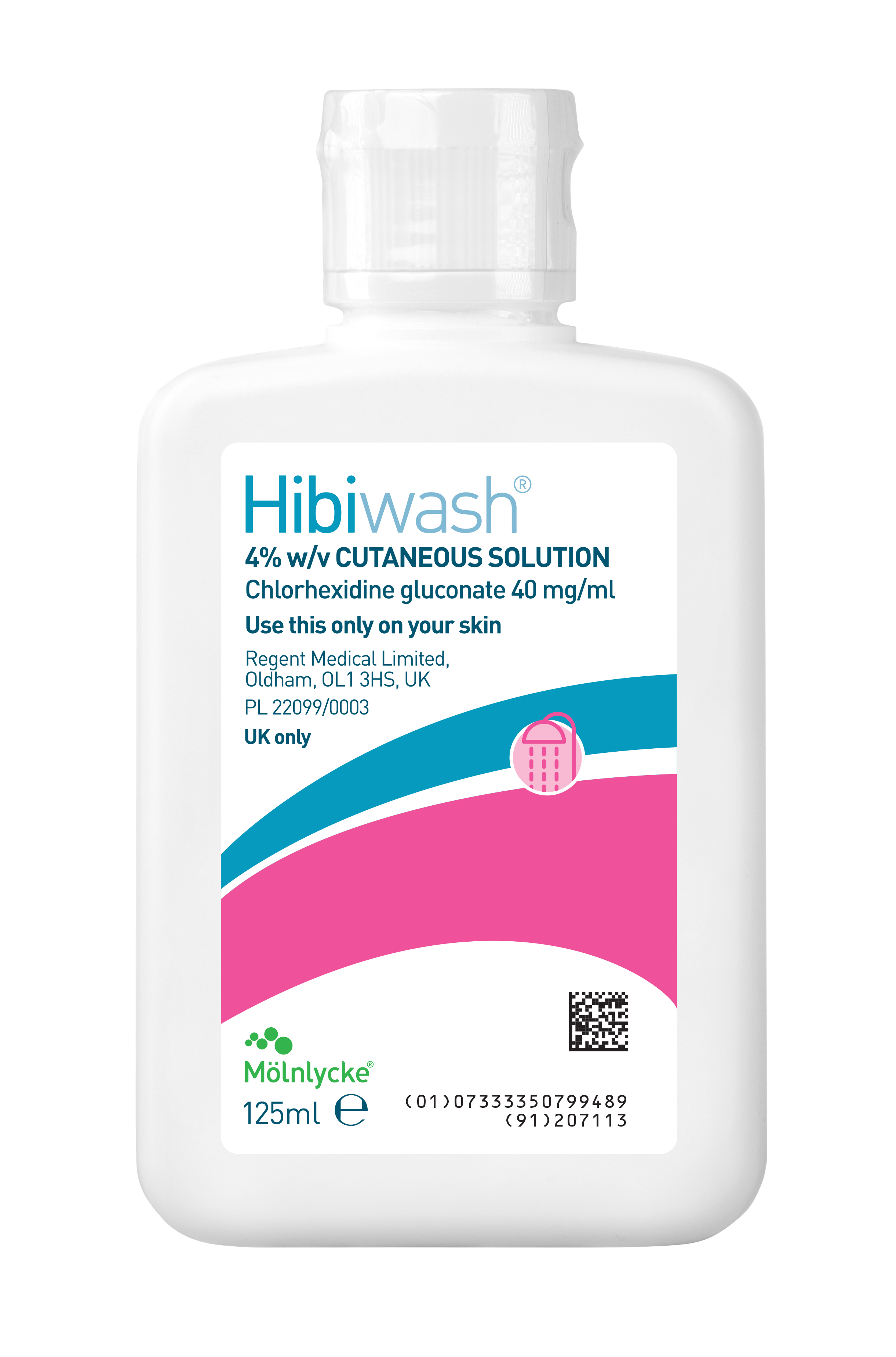
Antimicrobial skin cleanser (4% w/v chlorhexidine gluconate)
No colour, no fragrances, no traces of soya oil, more sustainable, increase compliance
Contains emollients and it is gentle on the skin, promoting the importance of skin’s integrity
Registered as Pharma
Claims: pHEur 5.1.11. ( bactericidal and yeasticidal) the European pharmacopoeia
primary source for quality control standards
Country | Product name | Proposed new SKU codes
UK | Hibiwash 5Ltrx1 UK | 2306UK005
 | Hibiwash 500mlx1 UK | 2306UK500
 | Hibiwash 250ml x1 UK | 2306UK250
 | Hibiwash 125ml UK | 2306UK125

Slide 30
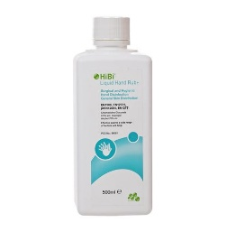
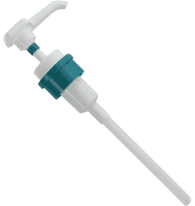
HiBi® Liquid Hand Rub+
Alcohol hand rub with Chlorhexidine Gluconate (Isopropyl alcohol 70% w/w) & Chlorhexidine digluconate
(as 20% solution - 0.50% w/v) for hygienic hand disinfection.
General skin disinfection
For professional use only
With emollients, gentle on the skin
Registered as Biocide
Product code 10009222
Test/EN Standards | Claims | Indications
EN1500:2013 For hygienic hand rub, establishing whether a product reduces the release of transient microbial flora on hands | Hand Hygiene | Alcohol hand rub for hygienic hand difinfection
EN14476 Virucidal enveloped viruses only |  | General skin disinfection
EN13727 Bactericidal
EN13624 Yeasticidal/Fungicidal
Denton GW; 2001. Chlorhexidine. Chapter 15 in Disinfection, Sterilization and Preservation. Ed. Block SS. Fifth Ed. Lippincott Williams and Wilkins.
Barbadoro P et al In vivo comparative efficacy of three surgical hand preparation agents in reducing bacterial loads. Journal of Hospital Infection 2014;86 (1): 64-67
Faoagali et al. Comparison of the immediate, residual, and cumulative antibacterial effects of Novaderm R, Novascrub R, Betadine Surgical Scrub, Hibiclens and liquid soap. American Journal of Infection Control 1995; 23(6):337-43.

Slide 31

Important information! Always read the label
Contradictions:
Incompatibilities:
Chlorhexidine is incompatible with soap and other anionic agents
Hypochlorite bleaches may cause brown stains to develop in fabrics, which have previously been in contact with preparations containing chlorhexidine
Known hypersensitivity to the product or any of its components, especially in those with a history of possible chlorhexidine-related allergic reactions

Slide 32
Whole Body Washing

Slide 33
Why is whole body washing (WBW) so important?
World Health Organisation (WHO) Surgical Site Infection Prevention Guidelines:
Whole-body bathing or showering with a skin antiseptic to prevent surgical site infections (SSI) is a usual practice before surgery in settings where it is affordable¹
The aim is to make the skin as clean as possible by removing transient flora and some resident flora¹
Chlorhexidine gluconate (CHG) 4% combined with a detergent is generally used for this purpose²
Preoperative showering with antiseptic agents is a well-accepted procedure for reducing skin microflora^{3,4}, and leads to a lower incidence of SSI⁴
1. WHO Surgical Site Infection Prevention Guidelines, Web Appendix 2, Summary of a systematic review on preoperative bathing,
2. Derde LP, Dautzenberg MJ, Bonten MJ. Chlorhexidine body washing to control antimicrobial-resistant bacteria in intensive care units: a systematic review. Intensive Care Med. 2012;38:931-9.
3. Garibaldi RA. Prevention of intraoperative wound contamination with chlorhexidine shower and scrub. J Hosp Infec 1988;11(Suppl. B):5-9.
4. Hayek et al. A placebo-controlled trial of the effect of two preoperative baths or showers with chlorhexidine detergent on postoperative wound infection rates. Journal of Hospital Infection 1987;10:165-172.

Slide 34
Examples of National guidelines and protocols - UK
Clinicians around the world are under constant pressure to reduce hospital-acquired infections (HAI). Infection rates are falling, yet 1 in 25 hospital patients still acquires a HAI.
Clinical studies show that a 4% CHG solution such as Hibiscrub® can help reduce infection rates, what could result in a significant economic gain¹.
Here are some examples of guidance in the UK:
GIRFT
NICE
Interventions made to improve SSI rates included:²
Pre-operative chlorhexidine wash
Consider nasal mupirocin in combination with a chlorhexidine body wash before procedures in which Staphylococcus aureus is a likely cause of a surgical site infection³
1. Rao, Nalini., et al. A Preoperative Decolonization Protocol for Staphylococcus Aureus Prevents Orthopaedic Infections. Clinical Orthopaedics and Related Research 466.6 (2008): 1343-348.
2. Getting It Right in Orthopaedics, REFLECTING ON SUCCESS AND REINFORCING IMPROVEMENT. A follow-up on the GIRFT (Getting It Right First Time) national specialty report on orthopaedics. February 2020
3. Surgical site infections: prevention and treatment NICE guideline, NG125

Slide 35

Questions?

